Slide 1
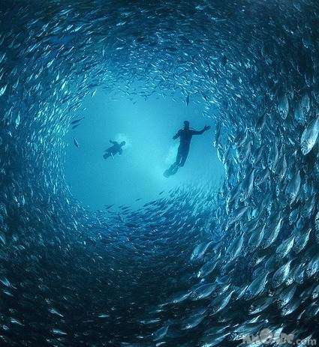

Spying on the fishes
Technology that biologists use to measure behavior

Slide 2
Why is it important to study fish behavior?
Understand population dynamics
Understand ecology and ecosystem function
Interpreting fisheries data
Needed to establish appropriate management and conservation
Protect people
Highly integrative field: biology, physics, chemistry, math, statistics, computer science, engineering

Slide 3
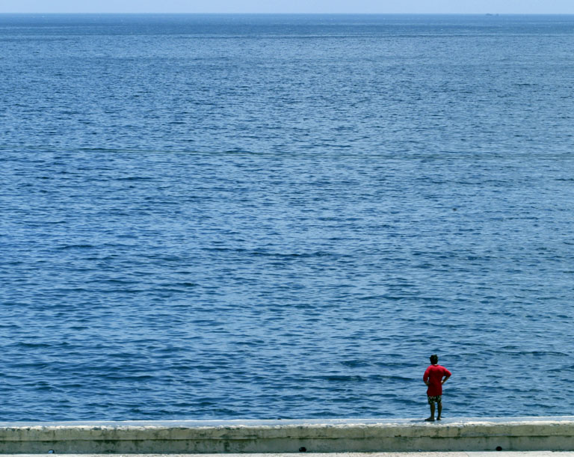
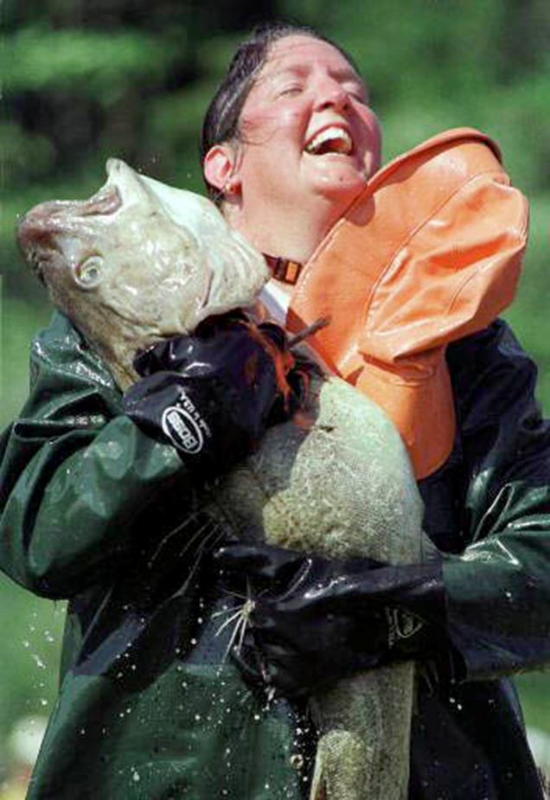
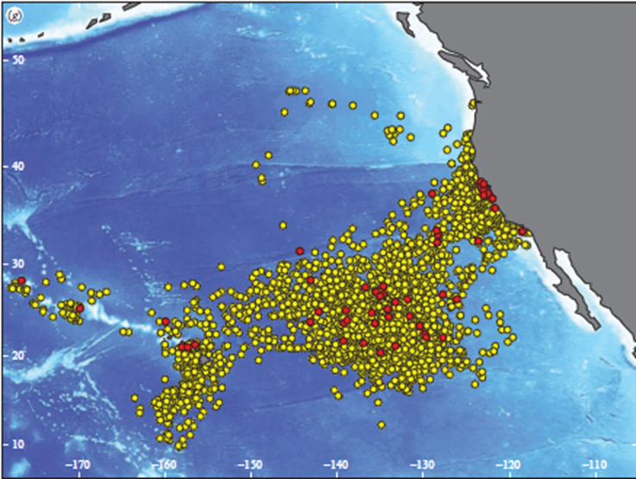
Challenges of studying marine fish ecology
It’s a big environment!
Most fish don’t like to be caught, probed, prodded, tagged, or killed!
Darn things move
Answering the hard questions can be very $$$
Technology limitations
Adult white sharks
Jorgensen et al. 2010

Slide 4
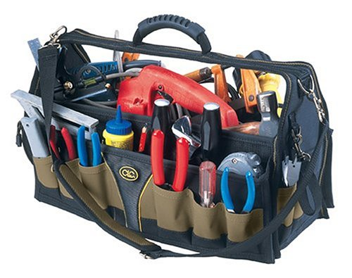
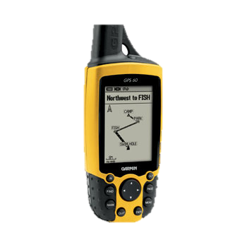
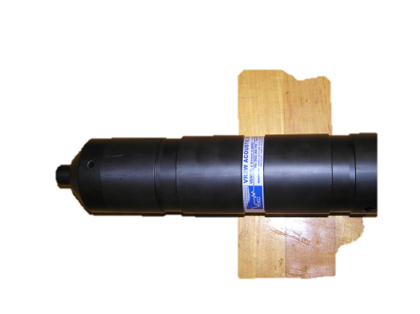


Whole new tool box!
Telemetry tools: acoustic, radio, satellite
  Wide variety of sensors
GPS technology
GIS – powerful spatial visualization and analysis tool
Better oceanographic data (SST, high res. mapping, Chl, current, etc)
Better models

Slide 5
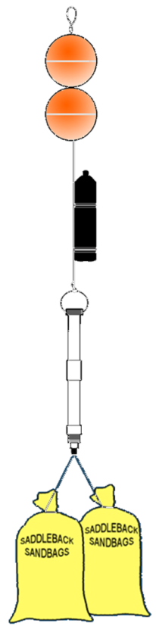
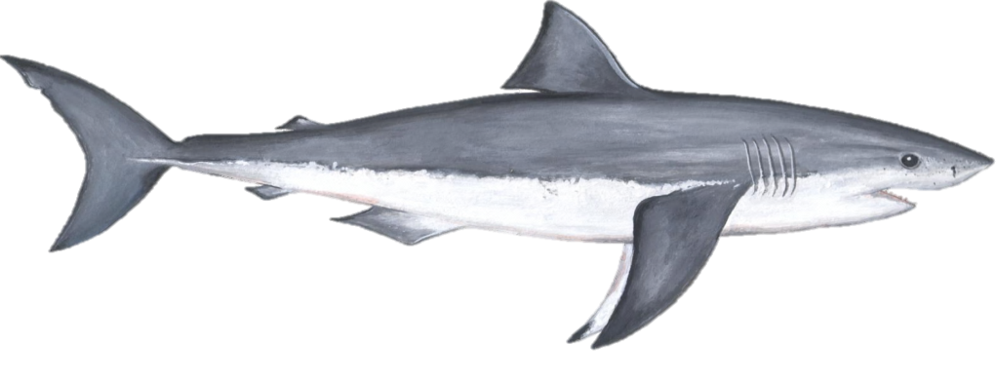
Acoustic telemetry
Uses an acoustic signal
Hz to kHz freq. range
Requires a transmitter and receiver/hydrophone
Works best in water (salt > fresh)
Variety of applications (active vs passive tracking)

Slide 6
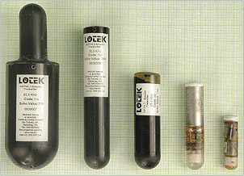
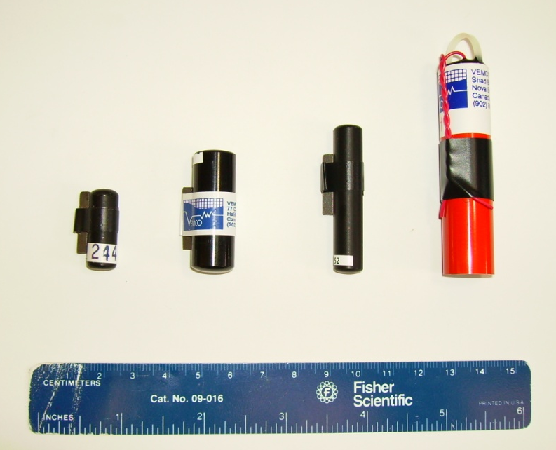
Acoustic transmitters
Now come in all sizes and battery lives
Tag juveniles to adults
Used for active short-term tracking
Many types of sensors (temp, depth, light, EMG, 3D acceleration, tail beat, pH…)
ID coded transmitters used for longer-term passive tracking
Costs: $180 - $900 USD each!

Slide 7
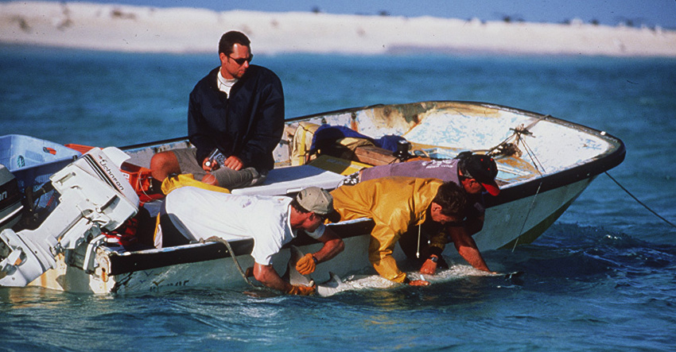
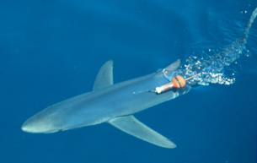
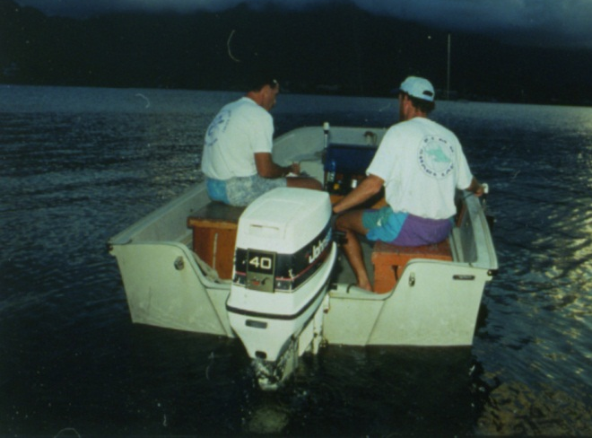
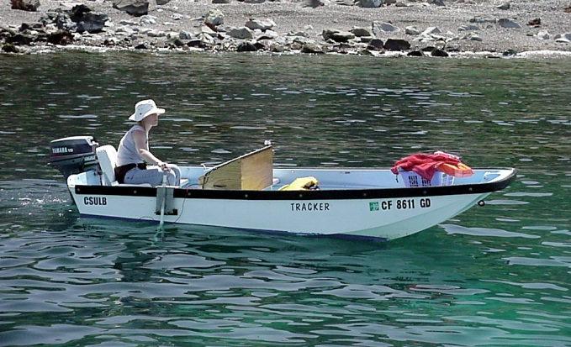
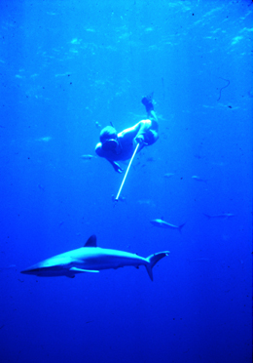
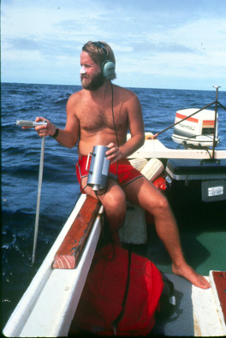
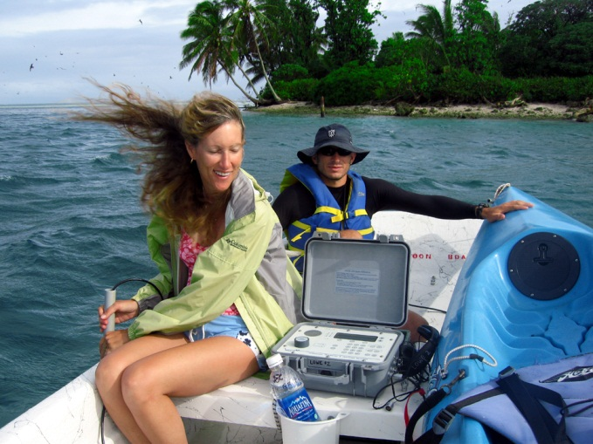
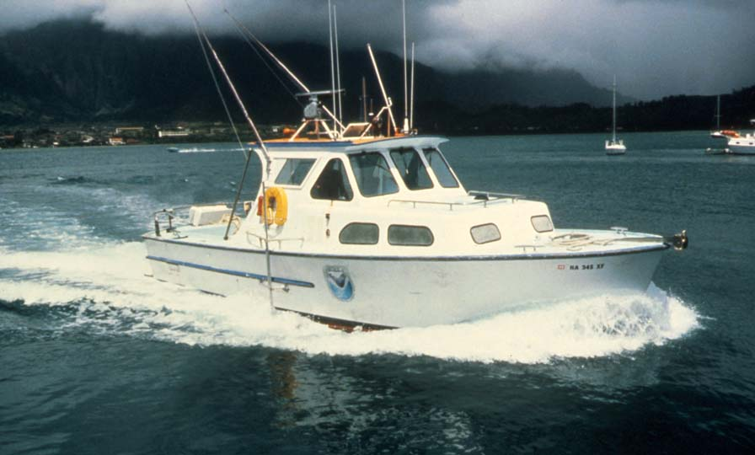
Early days of active acoustic tracking

Slide 8
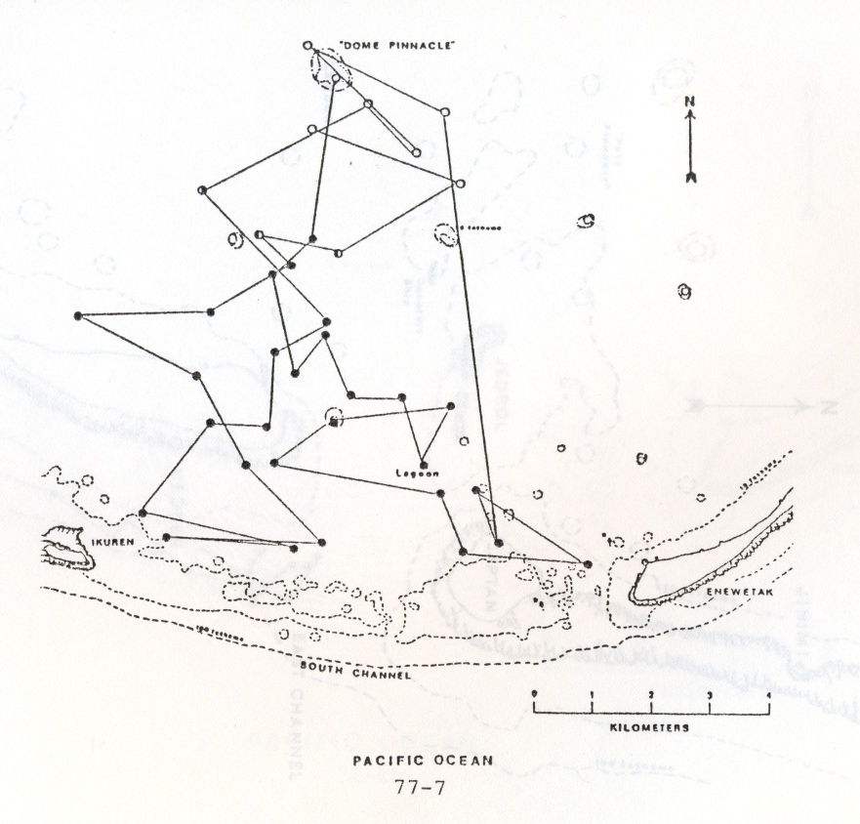
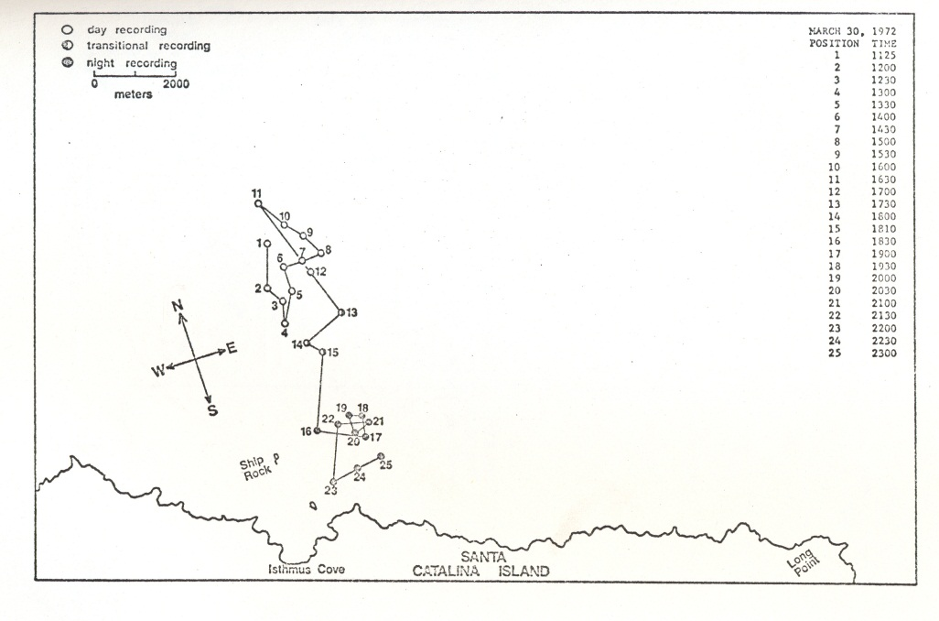
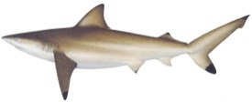
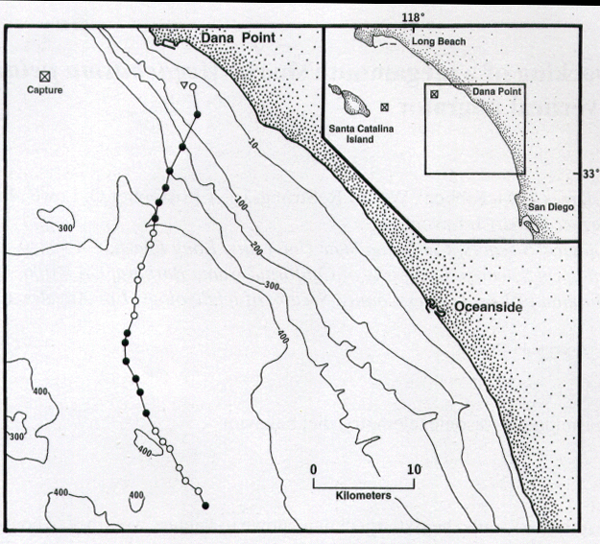
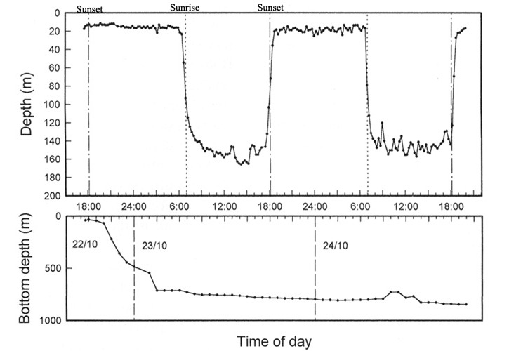
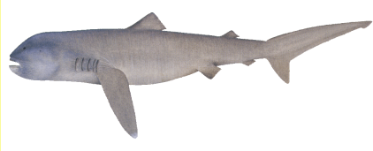
Mostly movements of big fish mostly descriptive

Slide 9
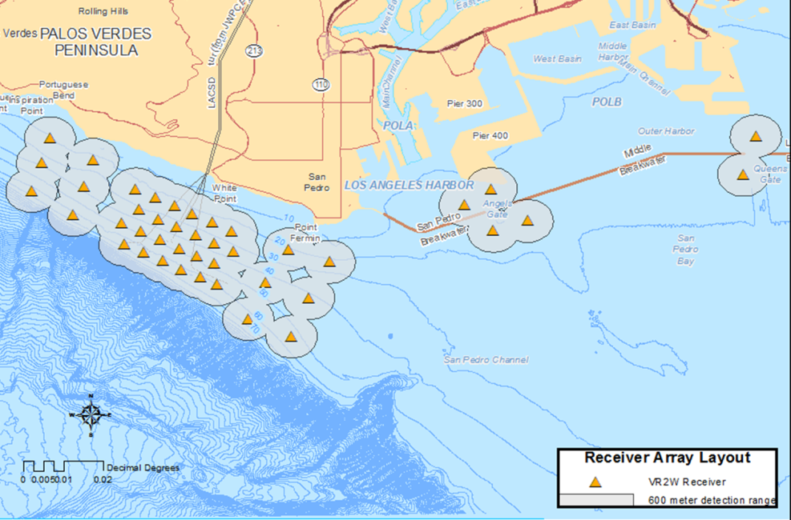
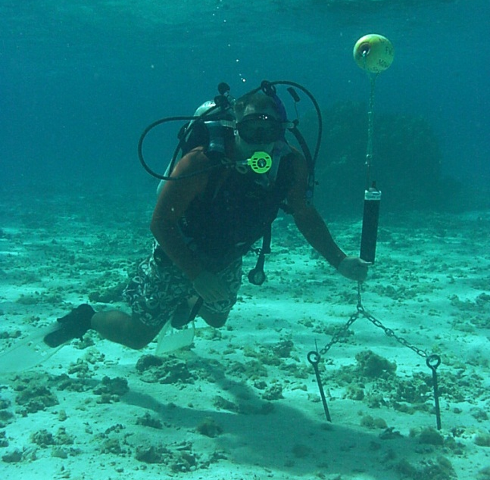
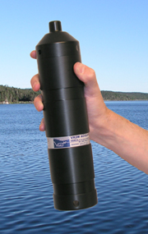
Evolution of passive acoustic tracking
Omnidirectional underwater acoustic receivers
Identify individuals by ID code #
Track multiple individuals simultaneously
Listening 24/7
Tags can last for years!

Slide 10
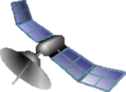
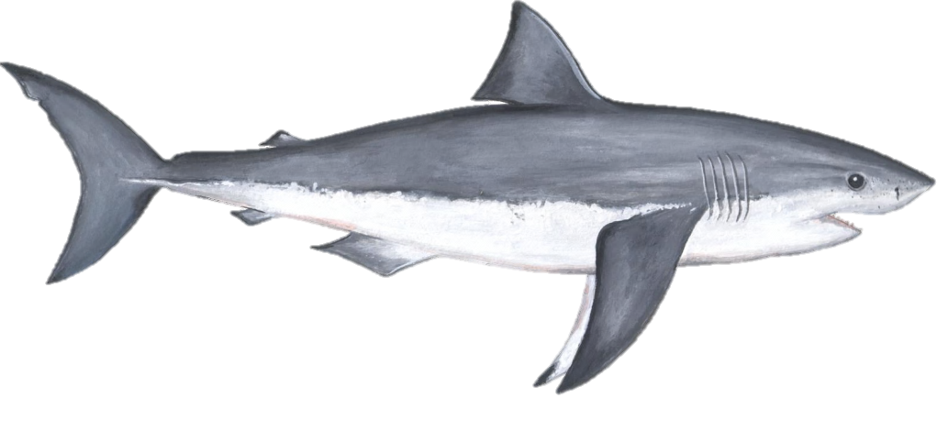
Satellite telemetry
Uses a radio signal
MHz freq. range
Works best in air, ok in FW
Only works when fish are at the surface

Slide 11
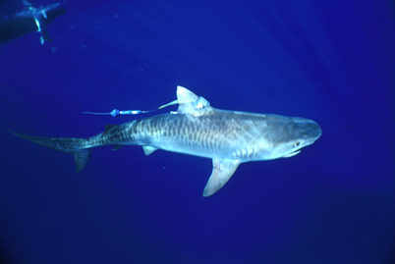
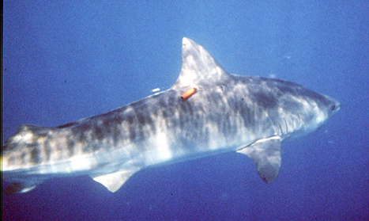
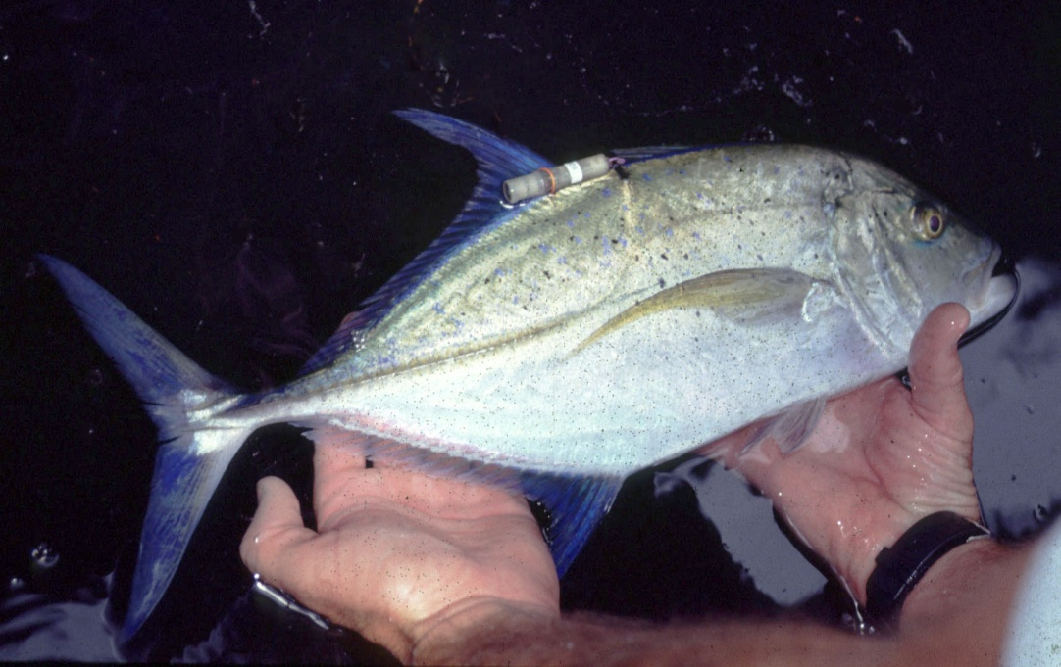
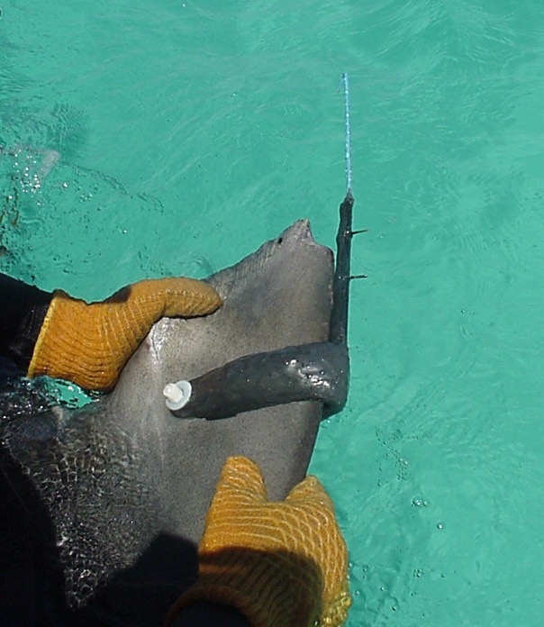
External tag attachment

Slide 12
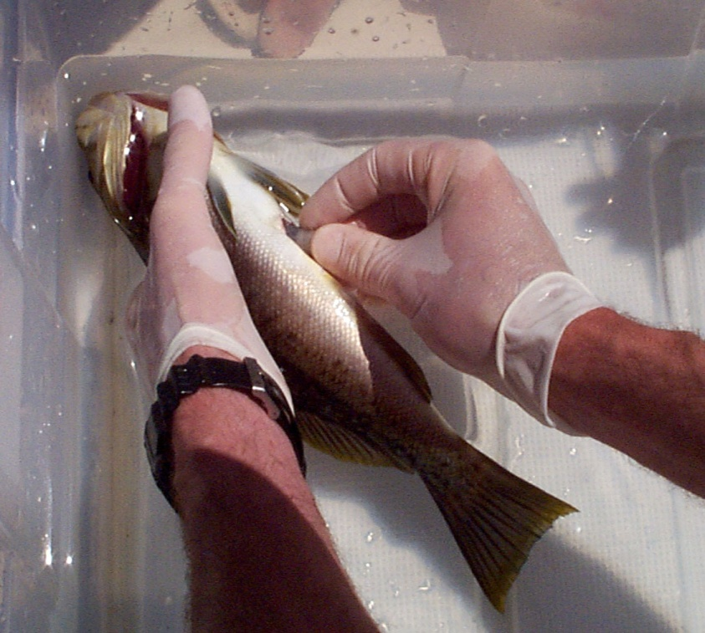
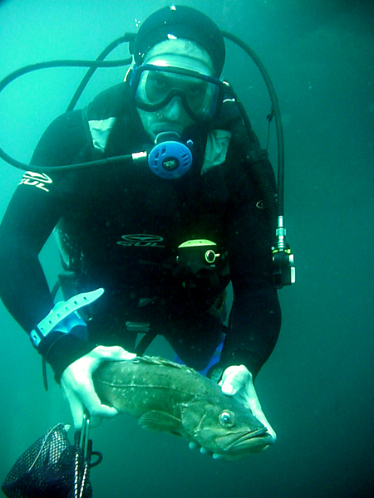
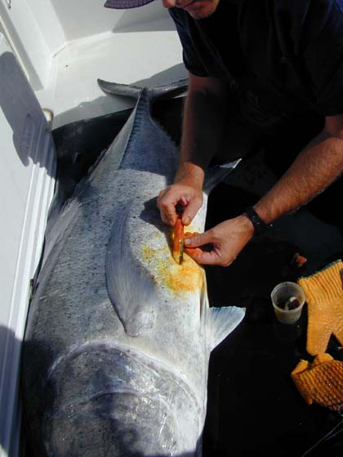
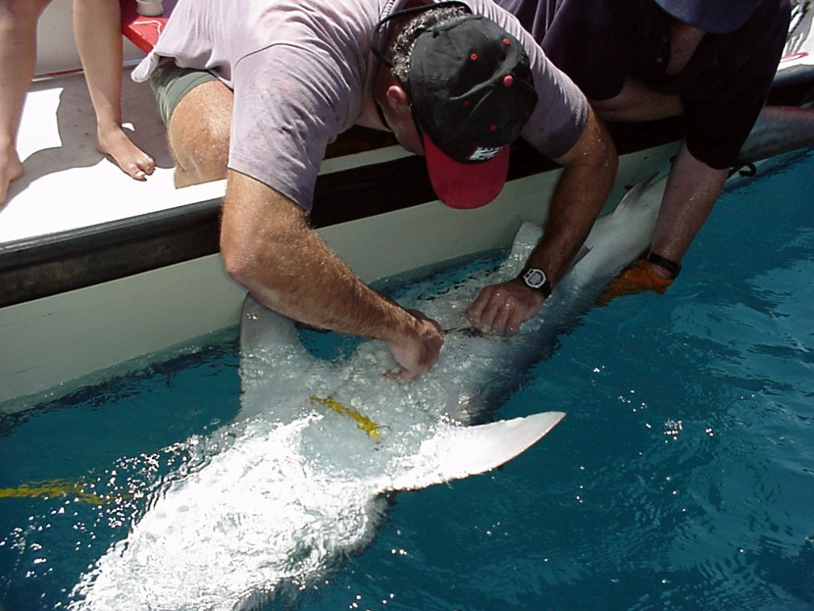
Internal tag attachment

Slide 13
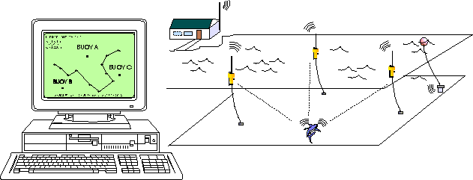
Automated active tracking
X-Y-Z positioning
Triangulates the fish’s position as it
swims through an array of hydrophones

Slide 14
Examples of applications…
Movements and habitat preferences of gamefishes for designing MPAs
Site fidelity, depth preference, behavior of gamefishes on offshore petroleum platforms
Movements of fishes in heavily contaminated areas
Thermoregulatory behavior of leopard sharks and round stingrays
Connectivity of estuaries

Slide 15

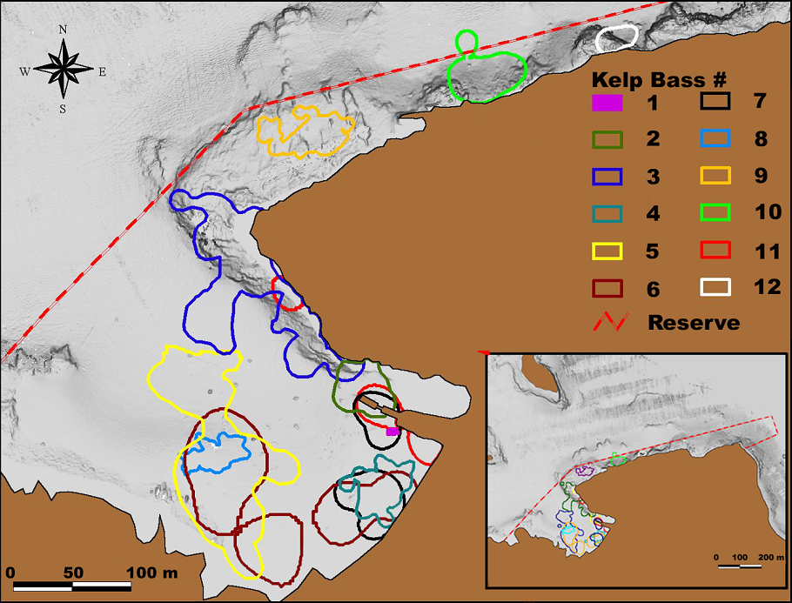
Kelp Bass
Lowe et al. 2003
Active and passive acoustic telemetry
Notes:
Avg. 3801 +/- 4015 m2, range 41-11000 m2, 793 tracking hrs.

Slide 16

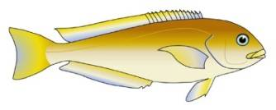
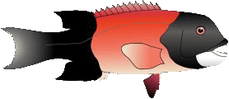
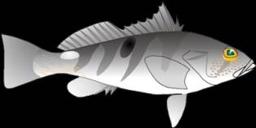

Time spent outside
ocean
whitefish
(n = 17)
CA
sheephead
(n = 16)
barred
sand bass
(n = 6)
kelp
bass
(n = 12)
Avg % time outside reserve

Slide 18
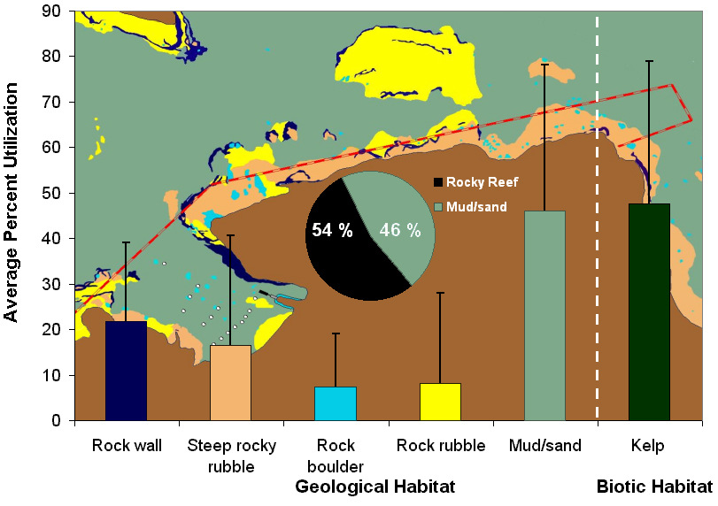
Habitat use – Sheephead

Slide 19

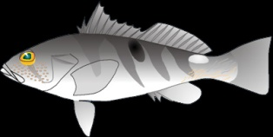
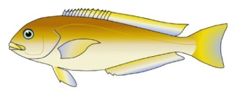
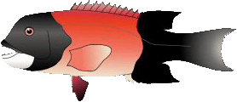
Distance-based edge use - daytime
Sand/mud
Edge
Rock
Kelp bass
Barred sandbass
Frequency of detection
Ocean whitefish
CA Sheephead
Distance from ecotone edge (m)

Slide 20
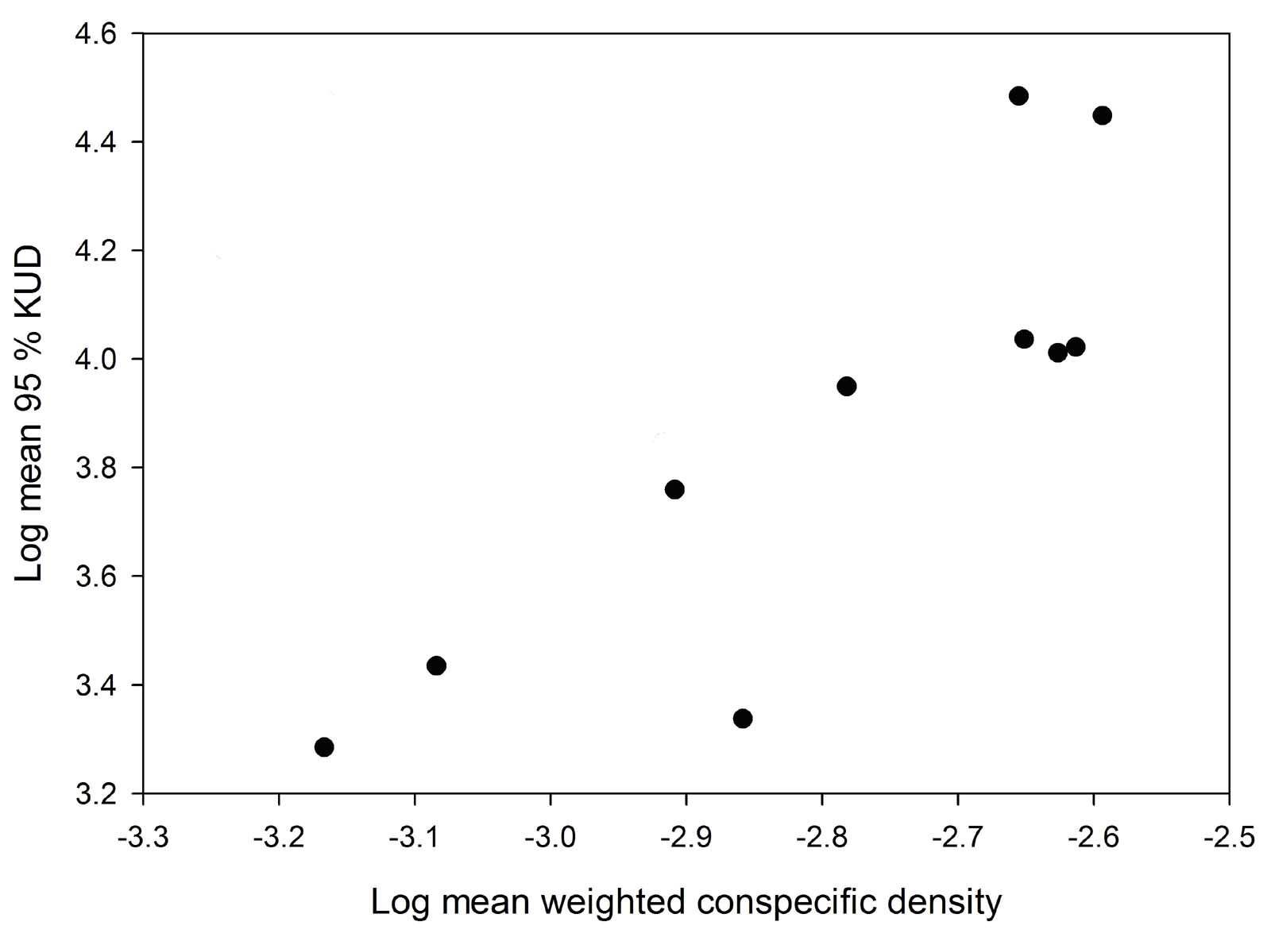
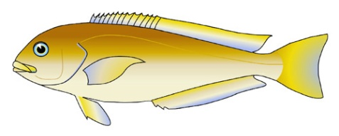
Ocean whitefish
Log home range size (m²)
Bellquist et al., 2008

Slide 21
Receiver array
Notes:
Now I’m going to talk about a method I am using to determine the long term site fidelity of sheephead. We have stationary listening stations in the reserve that pick up signals from coded transmitters, which have a special code for each fish.

Slide 22
% of fish left in the Reserve
ocean
whitefish
(n = 20)
kelp
bass
(n = 20)
CA
sheephead
(n = 20)
barred
sand bass
(n = 8)

Slide 23
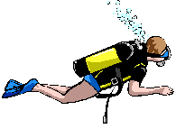




Site fidelity and depth preference
Spp. tagged:
Sheephead
Cabezon
Kelp rockfish
Grass rockfish
600’
60’
Notes:
23

Slide 24




Site Fidelity
Photograph: Chris Grossman

Slide 25


Summer
Cabezon are deep
Sheephead and kelp and grass rockfish are shallow
Warm surface waters
Strong thermocline
20’
70° F
60’
60° F
100’
50° F

Slide 26
Fall
Cabezon move shallower
Sheephead move deeper
surface waters cool
weak thermocline
20’
70° F
60’
60° F
100’
50° F

Slide 27
Winter
Cabezon and Sheephead remain at ~100’
surface waters cold
no thermocline
20’
70° F
60’
60° F
100’
50° F

Slide 28
Spring
Cabezon move deeper
Sheephead move shallower
surface waters warm
Thermocline reforms
20’
70° F
60’
60° F
100’
50° F

Slide 29


Feeding behavior

Slide 30
Leo 1, TL= 145cm, m= 16.3kg
2.1 % BW
2% BW
0.3 % BW
1% BW
0.3% BW
1 % BW
Papastamatiou & Lowe 2004

Slide 31



Slide 32

pH sensing acoustic transmitter
prototype
Transducer
pH electrode
10 cm

Slide 33
Blacktip reef sharks
Distinct indications of feeding events and meal sizes
Limitations:
  14 d of electrolyte
  Some shark may regurgitate earlier
Papastamatiou et al. 2007

Slide 34

Baby white sharks jumping for joy off Malibu!

Slide 35




White shark nursery

Slide 36


Slide 37


Slide 38


Slide 39


Slide 40





Slide 41

Where do they live?

Slide 42



Slide 43


Slide 44


Slide 45

Satellite transmitter track

Slide 46

less salty
Clearer
Warmer water
competitor
prey
murkier
saltier
colder water

Slide 47
AUV Shark Tracking
Systems Integration, State Estimation, and Autonomous Control
Christopher M. Clark (Harvey Mudd College), Christopher G. Lowe (CSULB)

Slide 48


Slide 49


Slide 50


Slide 51
Getting the answers
New technology has revolutionized the field
Need for more integration of ocean observing
greater interdisciplinary collaboration (STEM driven)

